Slide 1
Arrays
Tutorial #25

Slide 2
OBJECTIVE

Slide 3
Objective
The objective of this tutorial is to leave you with an understanding of how using an indexed list of items (an array) can be more efficient than trying to explicitly define each item.

Slide 4
TEXTPLANATION

Slide 5
Textplanation
When I was a kid, there was this video game called Berserk. You played a guy in the middle of an open square and what seemed like an endless swarm of enemy robots came at you from all sides. The game seemed impossible, but people were good at it.

Slide 6
Textplanation
Not me.

Slide 7
Textplanation
Other people.

Slide 8
Textplanation
Think about Berserk from a programmer’s perspective. You have to program the player and each robot. Let’s say there are 30 robots. Each of those objects needs a variable. That’s 31 variables. You can do that. It’s a lot of work, but you can do it.

Slide 9
Textplanation
But there’s a better way. Setting aside the player, you have 30 identical robots. Do you really want to have to juggle the 30 of them, plowing through if conditionals every time you need to see whether or not one touched the player?

Slide 10
Textplanation
If you answered yes, your sarcasm is not appreciated. The correct answer is no. You would put them into a list, specifically an indexed list otherwise known as an array.

Slide 11
Textplanation
An indexed list is a list of items (in this case robot variables) where each item has a number assigned to it. The first one is 0. So now, instead of coding the checks for each robot manually, you can tell the computer to check all of the robots, starting with robot 0.

Slide 12
Textplanation
Now let’s say you’re not using 30 robots. You're using a random number of robots, between 25 and 35. As the programmer, you can't handle that with explicit variables. With that number changing during every execution, you don't know how many variables to make. You can, however, tell the computer, during every execution, to create that random number of robots and put them into the list.

Slide 13
Textplanation
All software, web pages included, work with lots of information. Much of the time, your program will have to be able to house that information on the fly. It’s your job to create that housing and an array is your first best way to do that.

Slide 14
CONSTRUCTION

Slide 15
Construction
Create a folder somewhere on your drive and label it Arrays.
Open up notepad++.
Save the empty file to your folder and name the file “index.html”.
All first pages on a website are called index.
As you go through the images of the construction, add to your code. You will see comments with explanations of what you are doing. Those comments will change with each slide. You should not type my comments into your code.

Slide 16
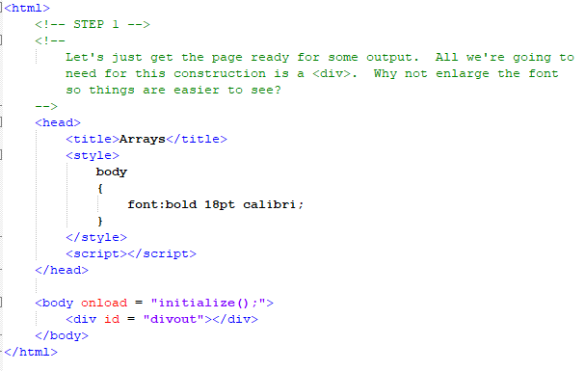
Construction

Slide 17
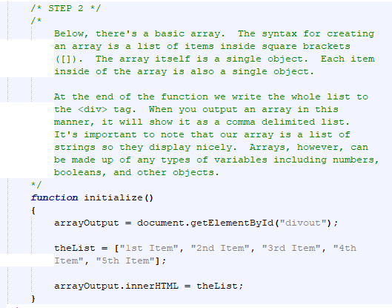
Construction

Slide 18
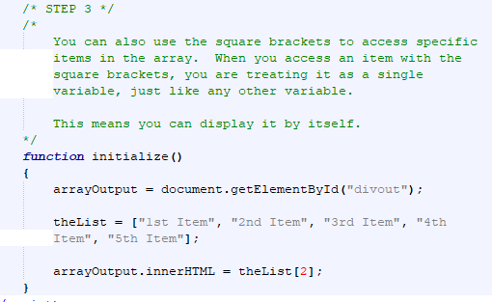
Construction

Slide 19
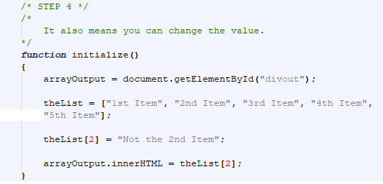
Construction

Slide 20
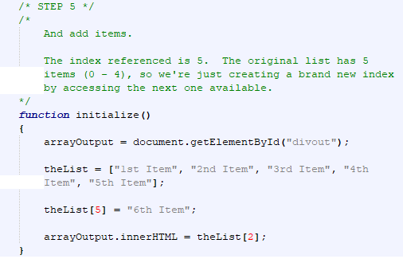
Construction

Slide 21
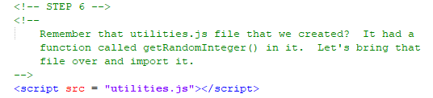
Construction

Slide 22
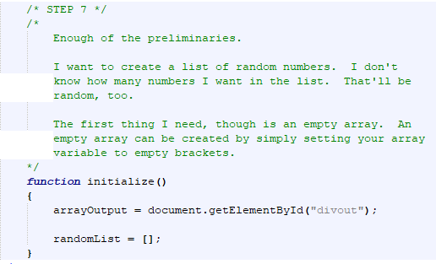
Construction

Slide 23
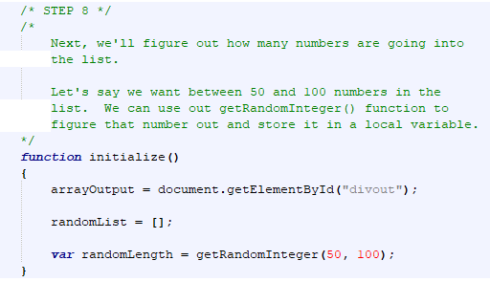
Construction

Slide 24
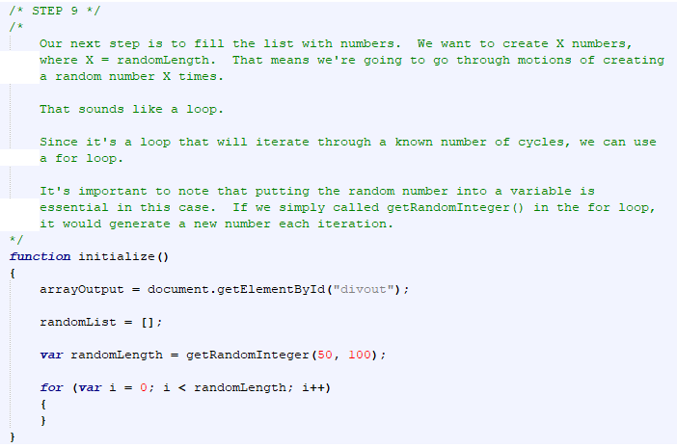
Construction

Slide 25
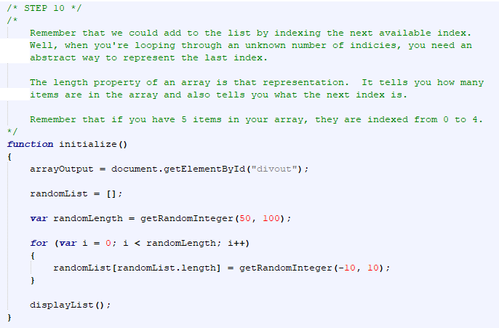
Construction

Slide 26
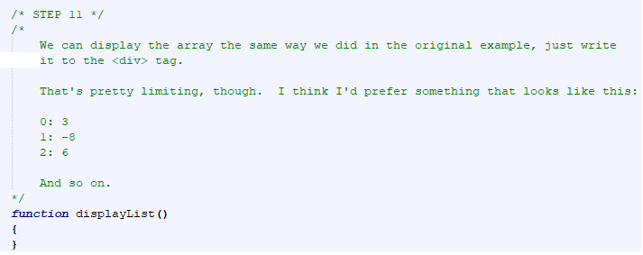
Construction

Slide 27
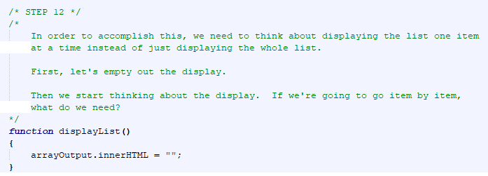
Construction

Slide 28
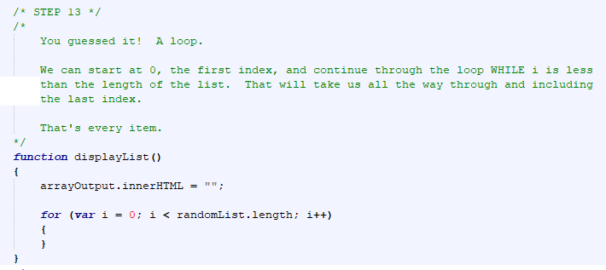
Construction

Slide 29
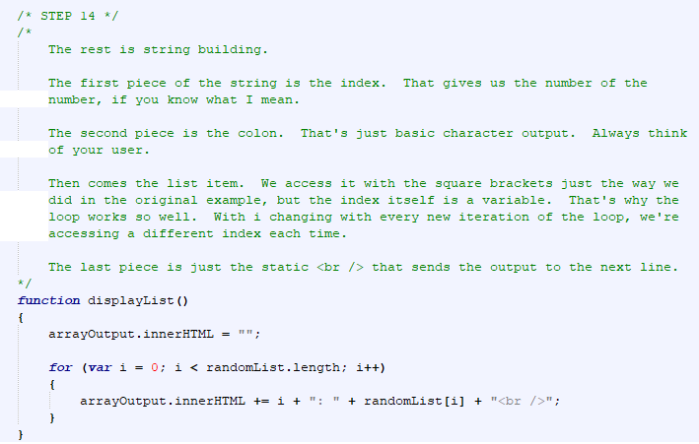
Construction

Slide 30
A DEEPER MEANING

Slide 31
A Deeper Meaning
An array is a list of items. Your item can be any type(s) of values so you can have an array of numbers, an array of booleans, and array strings, or an array of objects. Or you can mix them up. What would happen, though, if you had an array of arrays?

Slide 32
A Deeper Meaning
Now you have a 2-dimensional array. The first item in the array is an array. The 4th item in the array that is the first item of the array is whatever you want it to be (see the previous list). You can use this to create a grid. You can also go out to further dimensions, but there’s no real reason for that once you understand objects.

Slide 33
A Deeper Meaning
The syntax for a 2 Dimensional array is pretty intuitive. Just add an extra set of brackets.
twoDArray = [];
twoDArray[0] = [];
twoDArray[0][0] = “This is the first index of the first index of the array”;

Slide 34
A Deeper Meaning
An array is just one kind of data structure. A data structure is a way to organize information in your program. Arrays are numerically indexed lists. Other structures use pointers, where each piece of information can tell you what comes next or what came before or both or even more.

Slide 35
A Deeper Meaning
The DOM (remember the Document Object Model that represents your whole page?) is a complex data structure that works with multiple organizational methods.

Slide 36
FAQ

Slide 37
FAQ
Is a string an array?
A string is constructed similarly to an array. In fact, early languages didn’t have strings. If you wanted one, you’d have to build an array of characters.

Slide 38
FAQ
Can I access the characters in a string using square brackets?
Yes and no. In Javascript, you can read a character from a string using the brackets, but you can't overwrite it. So, if I alert (str[3]); I'll get a valid result. If I try to assign something str[3], it won't work.

Slide 39
ACTIVITY

Slide 40
Dice Table Revisited
We’ve already created a dice table where dice rolls are recorded on screen.
We now have the opportunity to record the dice rolls into an array.

Slide 41
Dice Table Revisited
Roll two dice a random number of times (between 25 and 100).
Store each result (the sum of the 2 dice) in an array.
Create an array with 13 indices (0 – 12) and put a 0 into each one.
Each time you roll a particular result, add 1 to the number at that index (if you roll a 10, go to index 10 and add 1 to the number there).
This will store the number of times you roll each result.

Slide 42
Dice Table Revisited
Output the data from the array to a table.
Create a second table with all of the relevant data, including the frequency of each result, the mean, the median, and the mode.
The tables should appear on the page side by side.

